Slide 1
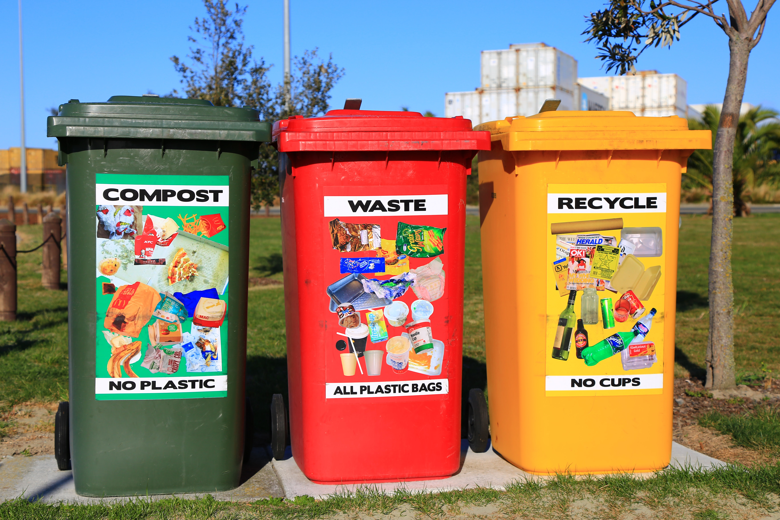
wASTE MANAGEMENT SYSTEM

Slide 2
SUBMITTED BY-
Name | ID
Arafat Islam | 19-39377-1
Turzo Roy | 19-40403-1
An Nazmus Sakib | 20-43056-1
Dewan Sadman Jawad | 19-40778-2
Md Salem Ahmed | 19-39383-1

Slide 3
Index
Introduction
Use Case Diagram
Class Diagram
Sequence Diagram
State Chart Diagram
Activity Diagram
Conclusion

Slide 4
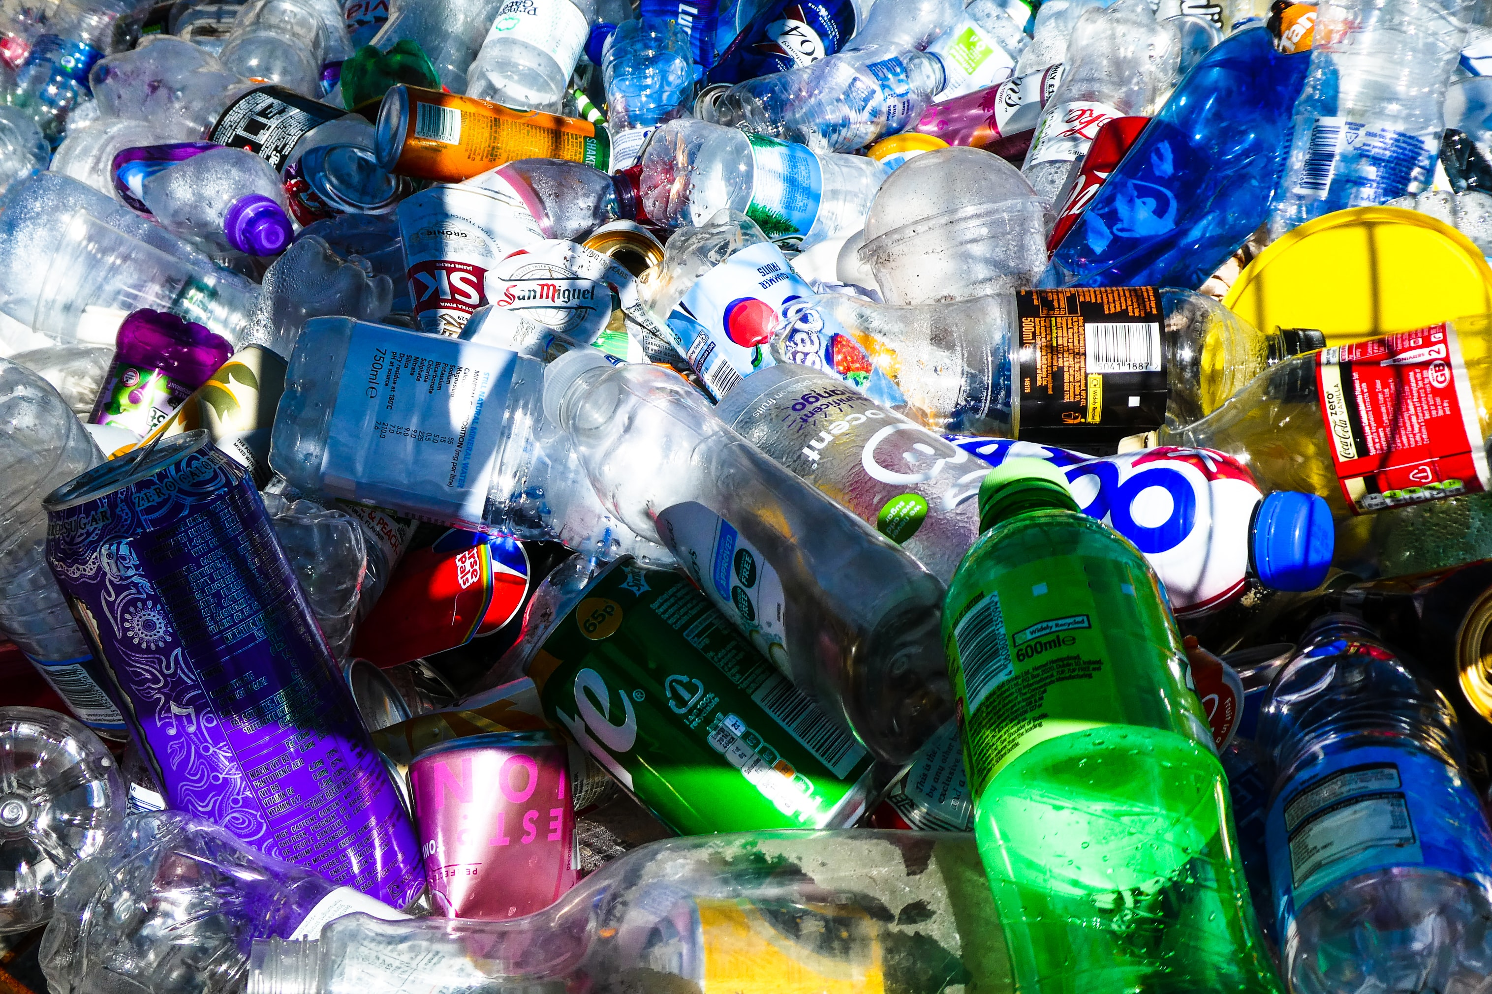
INTRODUCTION
Waste is a significant global issue. Increasing volumes of waste are being generated as the global population and living standards rise.
Current waste generation in Bangladesh is around 22.4 million tonnes per year.
So now is the right time to think about waste and how it can manage and turn it into useful products.

Slide 5
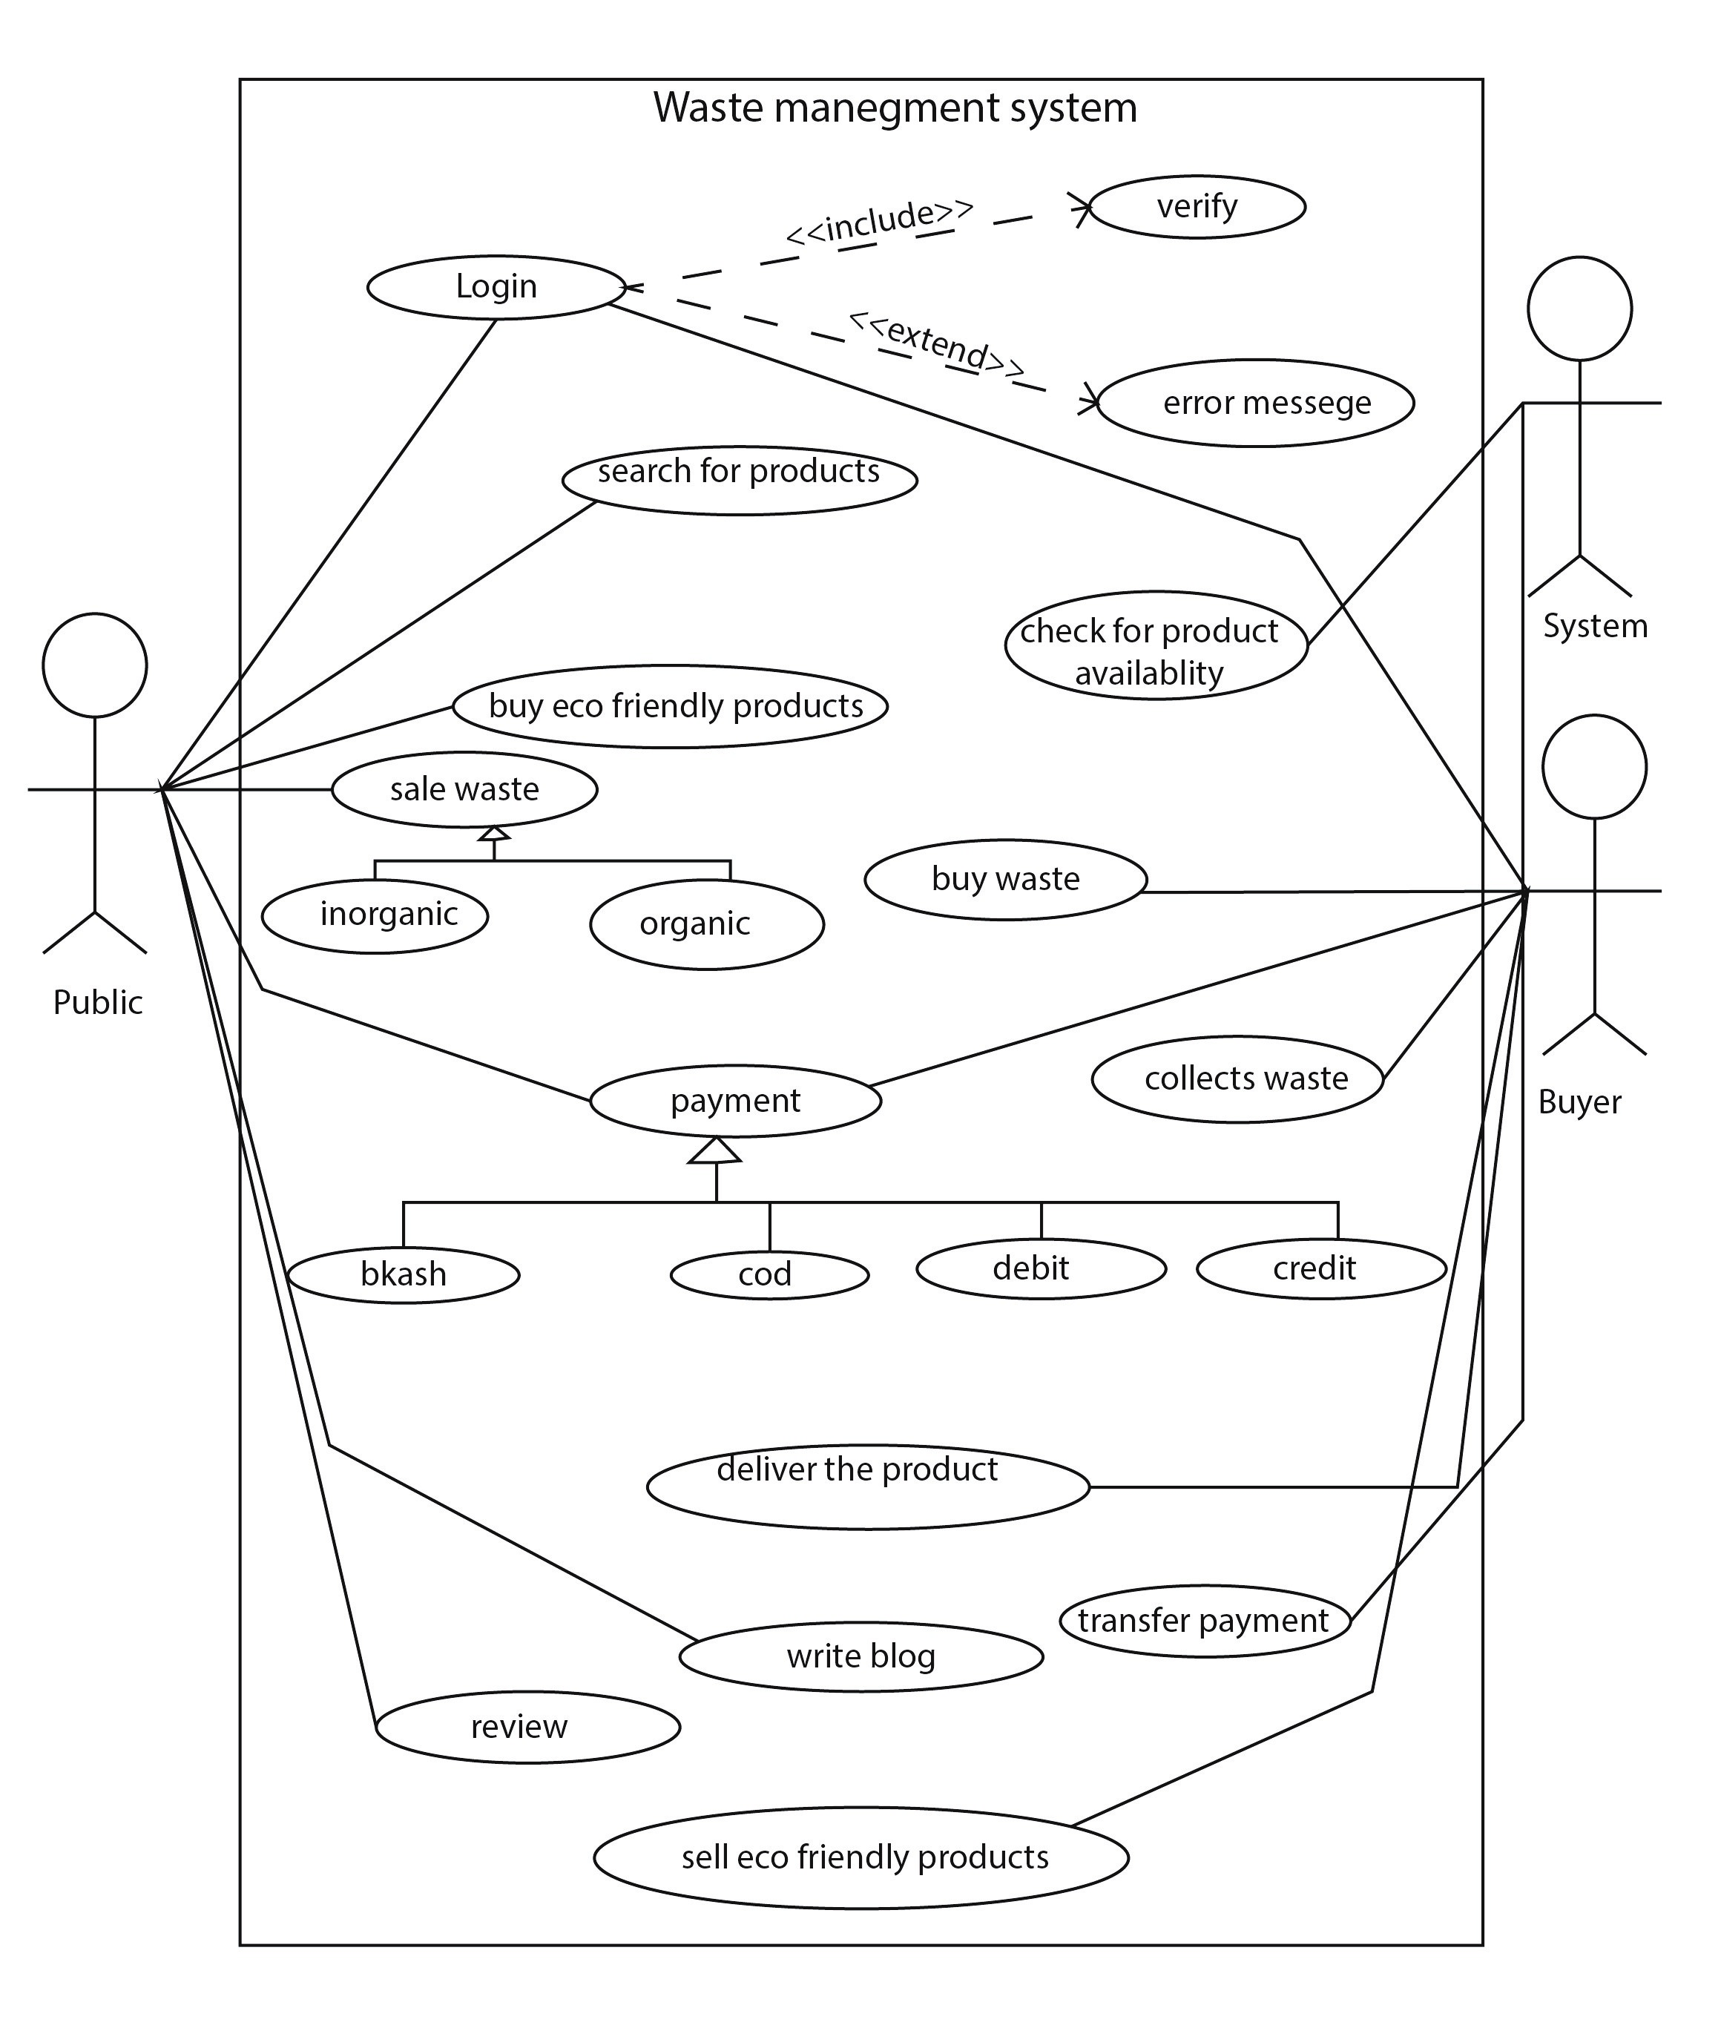
USECASE DIAGRAM
In the waste management system, Public and buyer login to their accounts and verify, if fail then shows an error message. The public can search for items and system check product availability and can add waste for sale. Public can buy eco-friendly products. Buyer can buy waste and collect waste and sell eco-friendly products.They buy and sell products through preferred multiple transaction policy like Bkash, cash on delivery, credit or debit card. Also public can review products and write blogs for social awareness.

Slide 6
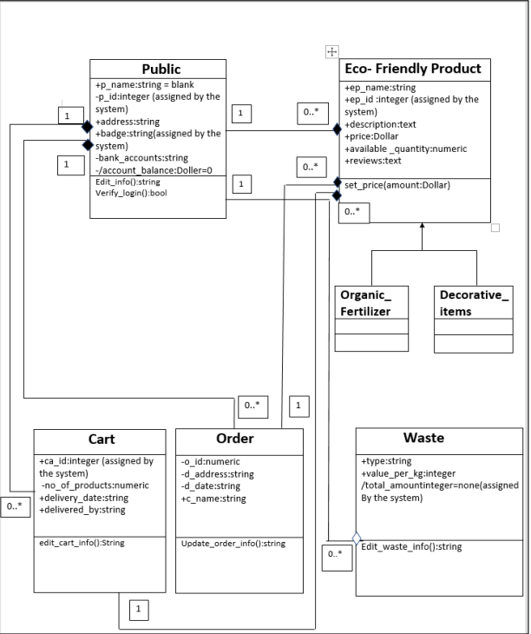
CLASS DIAGRAM
Class diagram includes five major classes like waste, public, eco-friendly products, cart and order. Here the class diagram includes the relation among the classes needed to deliver by the system.
For eco-friendly product there are two sub classes one is organic fertilizer and another one is decorative items.

Slide 7
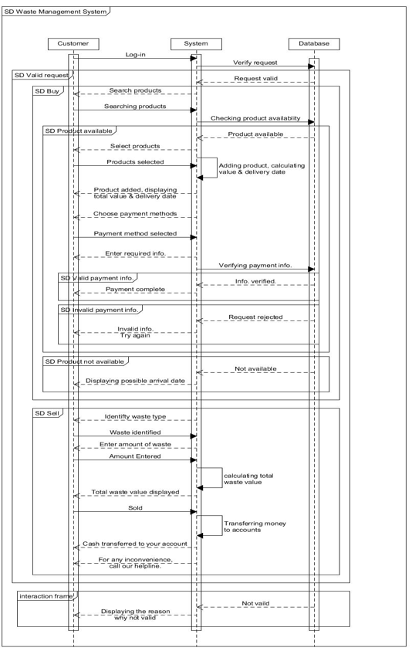
SEQUENCE DIAGRAM
In the sequence diagram,public act like customer and have to request for login with their right information which is available in the database. Customer can search for items and system checks the products availability. After selecting product customer will be shown product price and delivery date. They can choose payment method and fill up required information. After verifying payment will be done, if not then a error message will be shown. As the same way both buying and selling waste and eco-friendly products will happen. For any inconvenience customer can call our helpline.

Slide 8
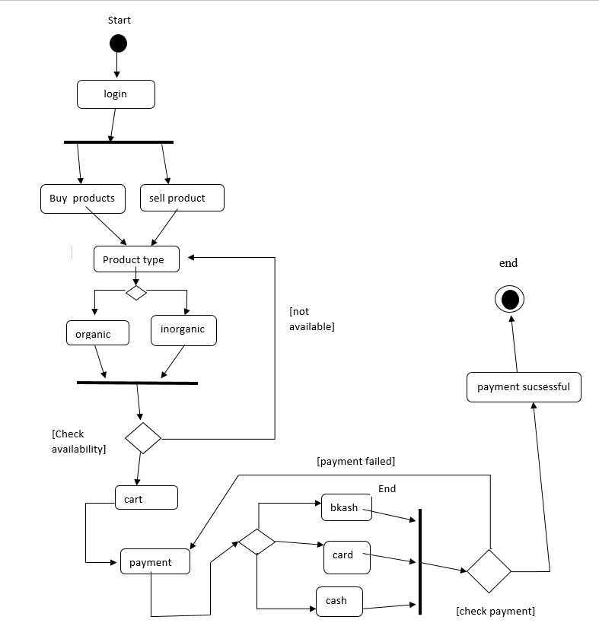
STATECHART DIAGRAM
Using the Waste Management System, customer and buyer first login to the system and system verify that. After that public can sell waste and buy eco friendly products if available. Buyer can buy waste and sell eco friendly products. After buying waste, buyer collects the waste. If the desired product is available public and buyer can buy products through preferred multiple transaction policy like Bkash, cash on delivery, credit or debit. If any verification failed then system shows a error message.

Slide 9
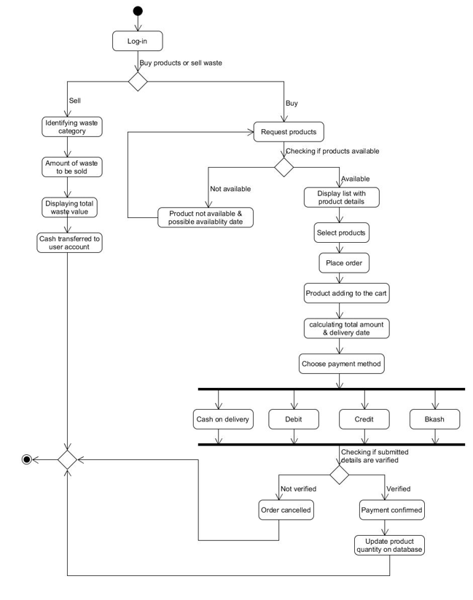
ACTIVITY DIAGRAM
In our waste management system, at first customer has to log-in. Then they can either sell waste or buy eco-friendly products. For sale, first identify waste category then add amount and price and cash transfer to user account. For buying eco friendly products at first request for the products, check if it is available, if not go to the request page again otherwise display products details. After that select products then place order with ammount and delivery time and then select payment type among cash on delivery, debit, credit or Bkash. If submitted data are verified then payment will be confirmed and update product quantity in database other wise order will be cancelled.

Slide 10
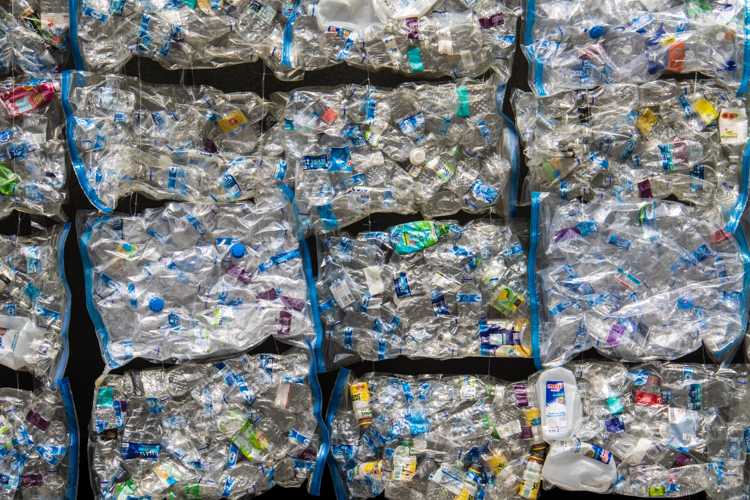
CONCLUSION
Production of waste in our time is more than ever & slowing it’s leading to global environmental change creating imbalancesThere can be multiple solutions to deal with waste management. The convenient way is recycling the waste make them into usable products. This process will not only reduce waste but also make sure it’s not harming the environment. It will also open a new income source for a lot of people. Even from the business prospective it’s feasible for the new growing e-commerce market.

Slide 11


Slide 12
Thank You

